Slide 1

Innovation idea submission at Chranz AG
digitalization of the process
Authors:
Anja Lambinus
Mengyang Li
Valeriia Afonina

Slide 2

Introduction
Service Provider for regional banks
Legal
IT management
Controlling
risk management and marketing
Push innovation
Builded a platform Chranz AG
take over the orchestration
Basis for exchange within regional banks
Target: the bank can concentrate in doing banking

Slide 3
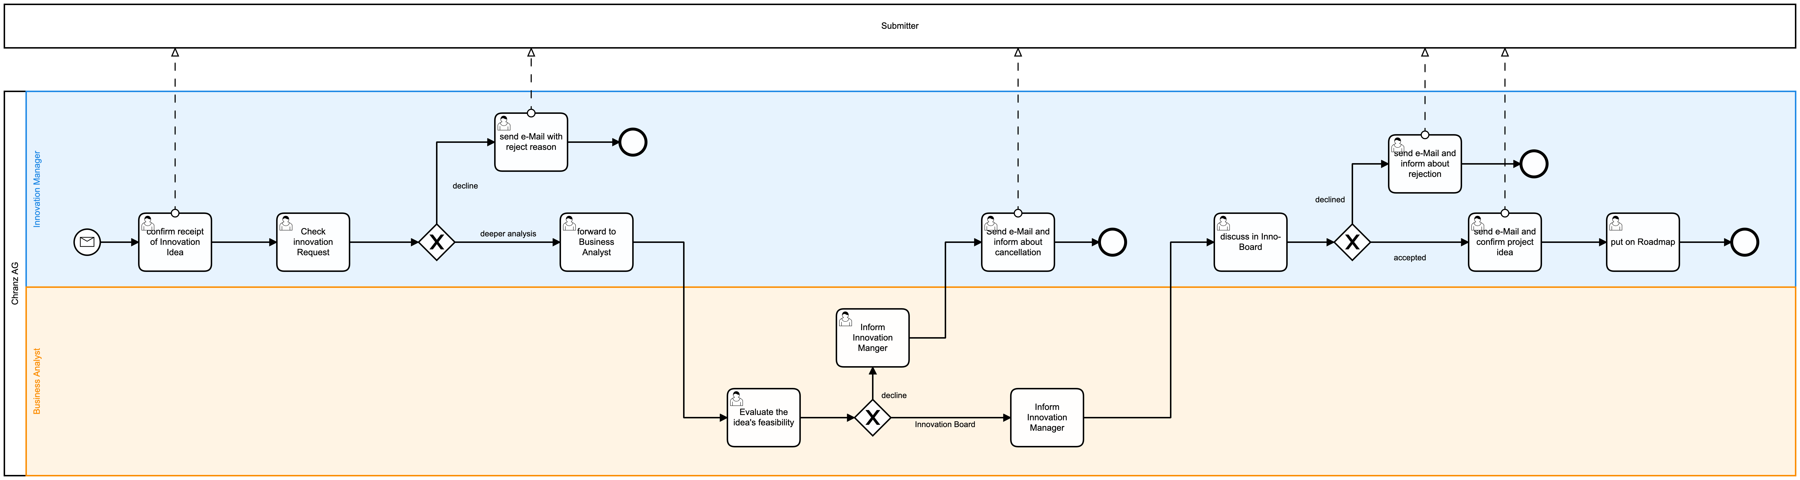
AS-IS process

Slide 4
AS-IS process

Slide 5

Issues
V1
Quality of request
Unstructured request by mail
Must-information are not covered
High error rate due to manual work
Unclear where the request is
Only update-information by cancellation
No overview about open requests
No clear rule for decision
Subjective decision on feeling
Not transparent
Innovation ideas are listed on a PowerPoint

Slide 6
Issues
V2
Quality of request
Unstructured request by mail
Must-information are not covered
High error rate due to manual work
Unclear where the request is
Only update-information by cancellation
No overview about open requests
No clear rule for decision
Subjective decision on feeling
Not transparent
Innovation ideas are listed on a PowerPoint

Slide 7
Issues
original
Quality of request
Unstructured by E-Mail with bad information content
Must-information are often not published and not covered in the request
Innovation ideas are listed on a PowerPoint
High error rate due to manual work (forgotten, not current)
Unclear where the request is
The requester get only an information when the idea was cancelled
For the manager in Chranz AG sometimes it is not always clear which request are open and where they are
No clear rule for decision
Innovation Manager and Business Analyst decided more on the feeling than on clear rules
To sum it up, due to the high level of manual activities, the process has a high potential for errors and is not very transparent.

Slide 8
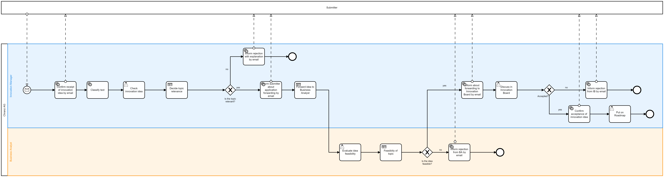
TO-BE Digitalized process

Slide 9


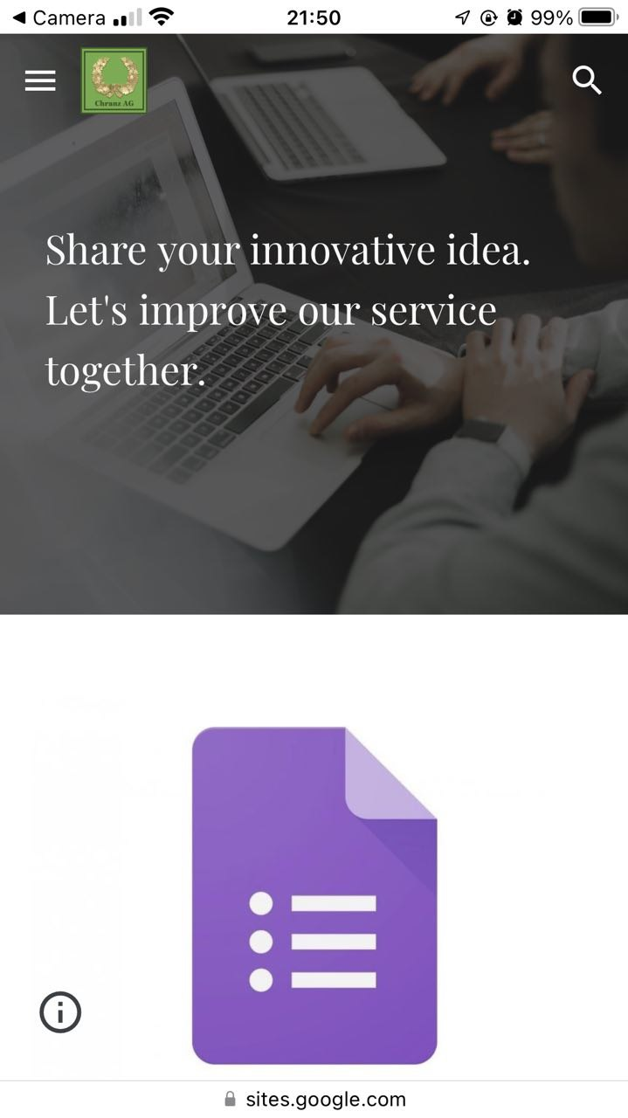
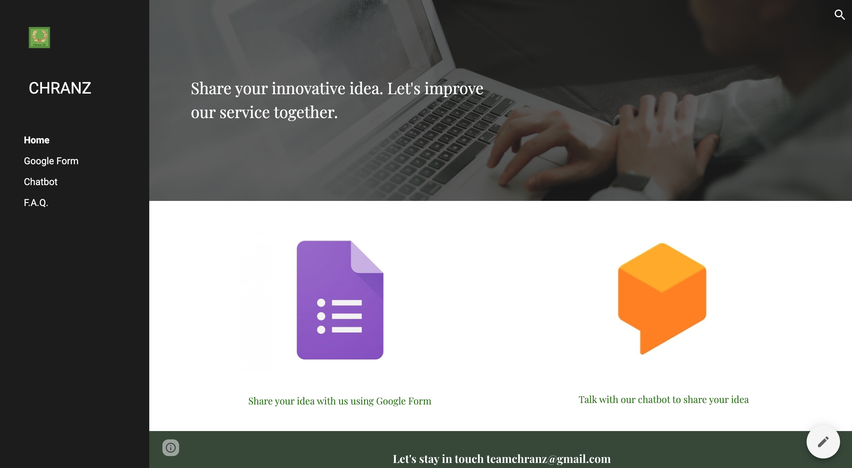
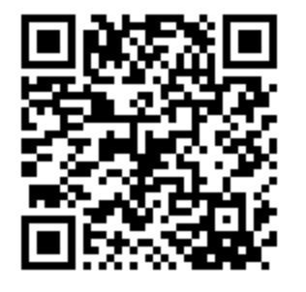
WEB PAGE
with adaptive design to start the process

Slide 10
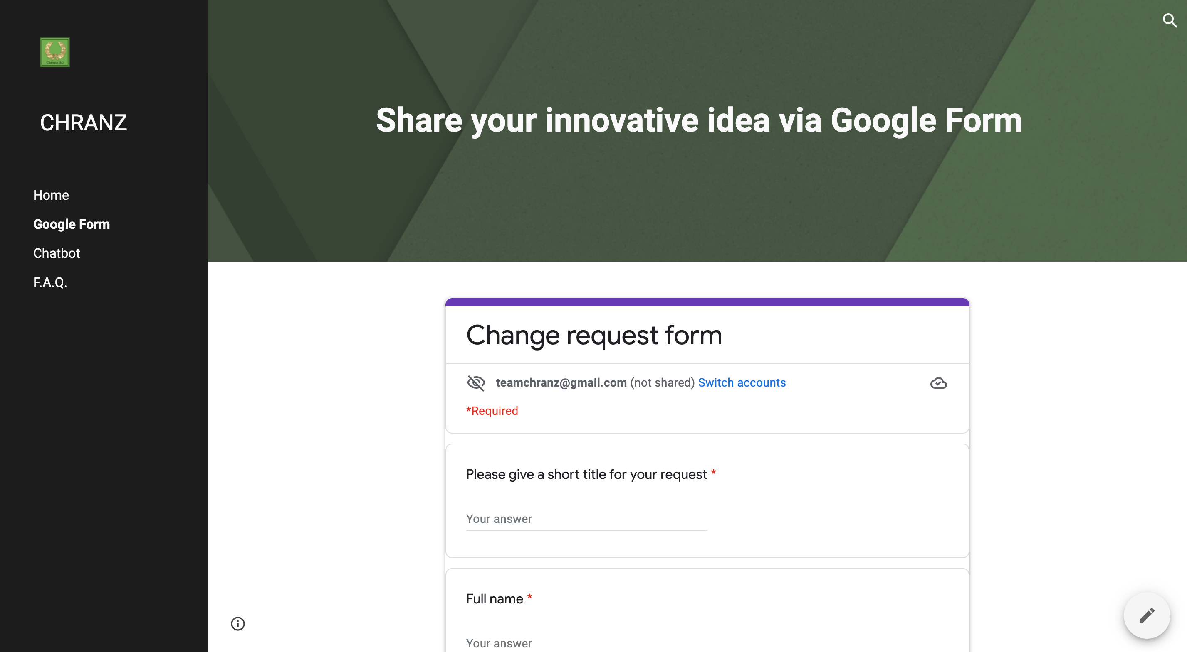
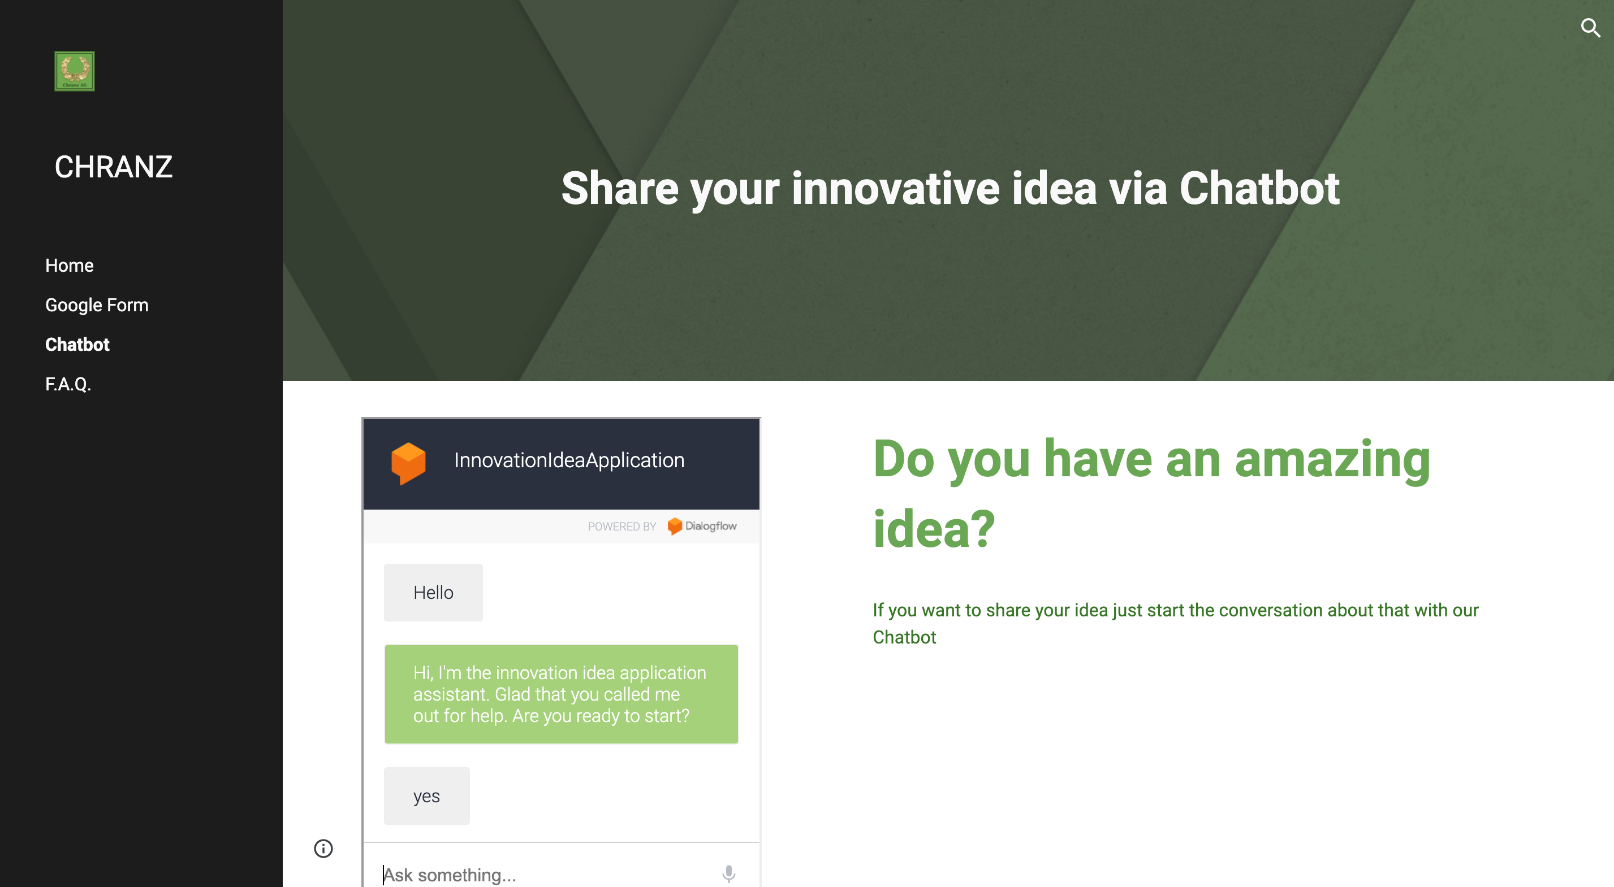
Two options for starting the process

Slide 11
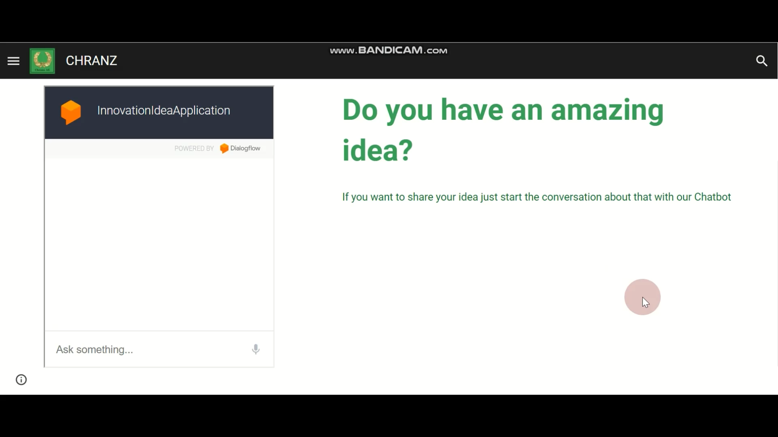
TO-BE Digitalized process. Chatbot

Slide 12

Improvements
V1
Implemented a workflow internal
Implementation of a Website inclusive FAQ
Structured submission with Google form or chatbot
Automated status update to the submitter after each change
Improve transparency – decisions has clear rules
Reduce working time

Slide 13
Improvements
V1
Implemented a workflow internal
Implementation of a Website inclusive FAQ
Structured submission with Google form or chatbot
Automated status update to the submitter after each change
Improve transparency – decisions has clear rules
Reduce working time

Slide 14
Improvements
Basis for slide before
Implemented a workflow internal
Implementation of a Website inclusive FAQ
Structured submission with Google form or chatbot
Automated status update to the submitter after each change
Improve transparency – decisions has clear rules
Reduce working time

Slide 15
Improvements
original
The requests are only accepted by means of a Google form or via a conversation with the DialogFlow chatbot so the submitter knows immediately which information has to be provided
The request is checked immediately after receipt and automatically assigned to a topic using text mining to facilitate the work of the Innovation manager
The system then checks the request according to defined criteria and decides whether the topic must be rejected or checked in more detail to make the process more transparent.
The assessment by the business analyst is carried out manually. However, there are fixed criteria that have to be checked and thus define the decision about a further assessment.
After the decision about the feasibility the submitter will be informed automatically again.
At the end, the Innovation Board is again informed by mail and, if the decision is positive, the innovation is placed on the roadmap.

Slide 16

Outlook
V1
POC was successful
Automate additional process - e.g. Roadmap planning
Connection to other process – e.g. Change Request, Roadmap
Reduce process time
Improve transparency – decisions has clear rules
Reduce working time

Slide 17
Outlook
Basis for slide before
POC was successful
Automate additional process
e.g. Roadmap planning
Connection to other process
e.g. Roadmap planning
Chang Request
Reduce process time

Slide 18
Conclusion
original
Positive
The request is standardized and necessary information are communicated
For each request it can be checked in Camunda where it is
The requester is informed regularly per Mail about the status
The decisions for a cancellation or go further are clear defined
The working time per employee could be reduced due to automated tasks
Negative
Process time could not be reduced as the Innovation Board is needed for final positive decision
The innovation process has no interface to the roadmap or Change Request at the moment. In this case it cannot be forwarded automated, the innovation process has the cancelled and the other process has to started manually

Slide 19
Thank you for your attention!

